Slide 1

CLASSIFYING PERSONAL INCOME
Project by :
Kanchan R. Bhamare

Slide 2
Problem Statement
• “Subsidy Inc.” delivers subsidies to individuals based on their income.
• Accurate income data is one of the hardest pieces of data to obtain across the world.
• Subsidy Inc. has obtained a large data set of authenticated data on individual income, demographic parameters, and few financial parameters.
• Subsidy Inc. wishes us to: Develop an income classifier system for individuals.

Slide 3
The Objective is to :
Simplify the data system by reducing the number of variables to be studied, without sacrificing too much of accuracy. Such a system would help subsidy Inc. in planning system subsidy outlay , monitoring and preventing misuse.

Slide 4
Variable Description size: 31,978 x 13 File : r'C:\Users\User\Downloads\income(1) (1).csv'
Variables | Data Type | Description | Categories of Variable
Age | Integer | The age of the individual in years | -----
Job Type | String | Working status of a person ,which sector does he work in | Federal-gov, Local-gov, private & 5 more…..
Ed Type | String | The level of Education | 10th , Masters, Doctorate and 13 more…..
maritalstatus | String | The marital status of the individual | Divorced, Never-married, Married-AF – spouse, and 4 more….
Occupation | String | The type of work the individual does. | Armed-Forced, Sales, Tech support, and 11 more

Slide 5
Variable Description size: 31,978 x 13 Data File : r'C:\Users\User\Downloads\income(1) (1).csv'
Variables | Data Type | Description | Categories of Variable
Relationship | string | Relationship of individual to his/her household | Husband, wife, own- child & 3 more
race | String | The individual’s race | Black, white and 3 more …
gender | String | The individual’s gender | Male,female
capitalgain | integer | The capital gains of the individual | ----
capitalloss | integer | The capital losses of the individual | ----
hoursperweek | integer | The no. of hours the individual works per week | ----
nativecountry | string | The native country of the individual | United State, Cambodia, Canada & 39 more….
SalStat | string | The outcome variable indicating whether a person’s salary status | Less than or equal to 50,000, Greater than 50,000

Slide 6
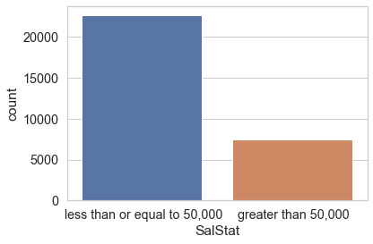
Frequency distribution of 'Salary Status'
75 % of people's salary status is <= 50,000 and 25 % of people's
salary status is > 50,000

Slide 7
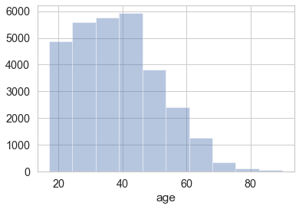
Histogram of Age
People with age 20-45 age are high in frequency

Slide 8
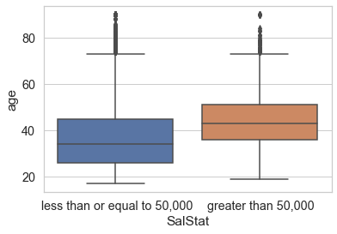
Box Plot - Age vs. salary status
To check how salary status is affected by the age. people with 35-50 age above are likely to earn more than 50,000 USD and people with 25-30 likely to earn less than 50,000 USD.

Slide 9
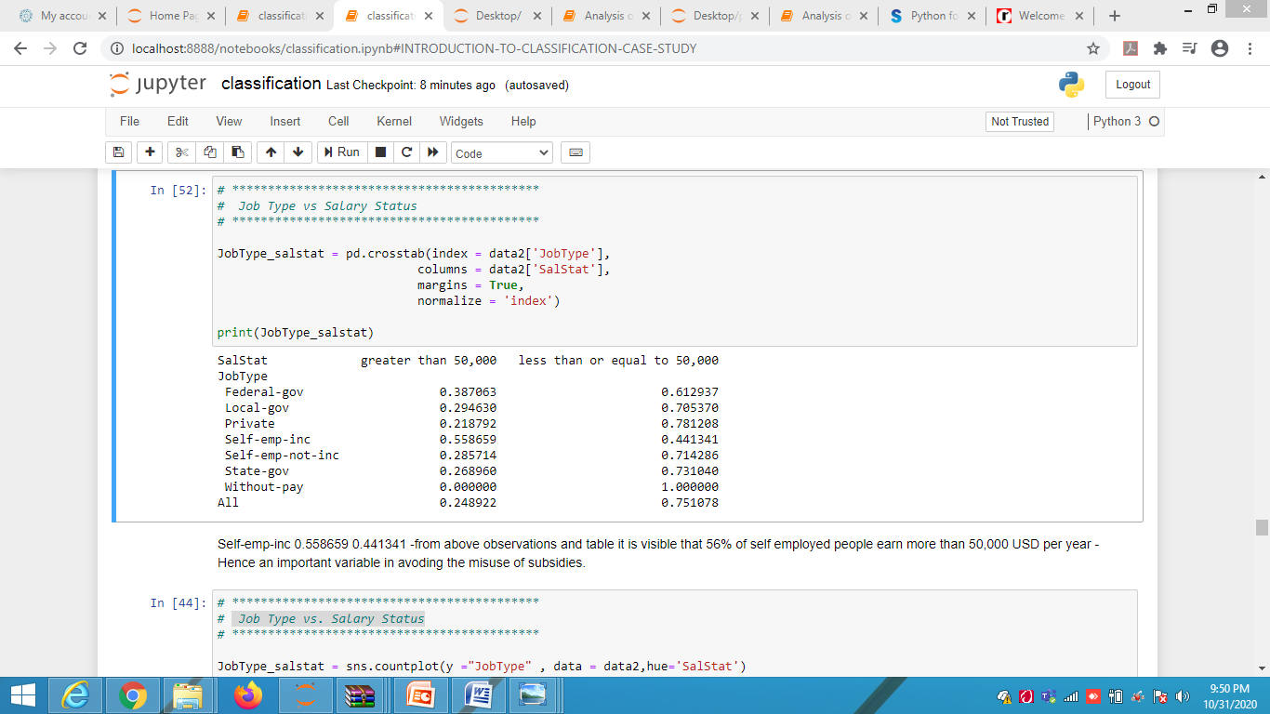
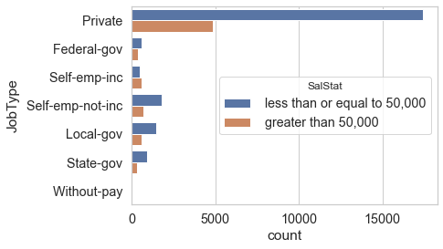
Job Type vs. Salary Status
From the above table it is visible that 56% of self employed people earn more than 50,000 USD per year.
Hence an important variable in avoiding the misuse of subsidies.

Slide 10
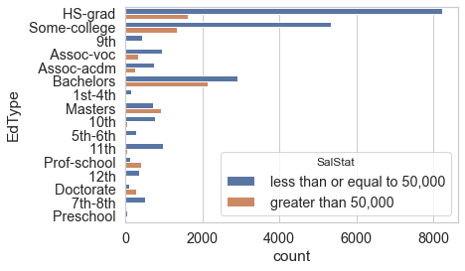
Education vs. Salary Status

Slide 11
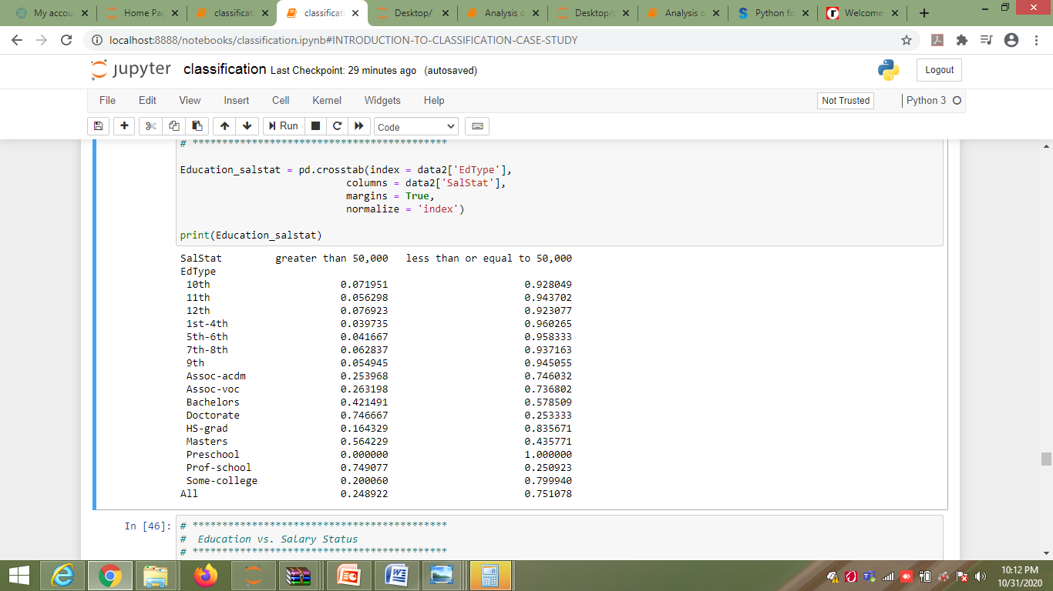
Education vs. Salary Status
From the above table and graph we can see that people who have done Doctorate, Masters, prof-school are more likely to earn above 50,000 USD per year when compared with others. Hence an influencing variable in avoiding the misuse of subsidies.

Slide 12
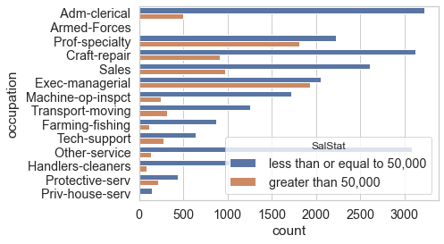
occupation vs. Salary Status

Slide 13
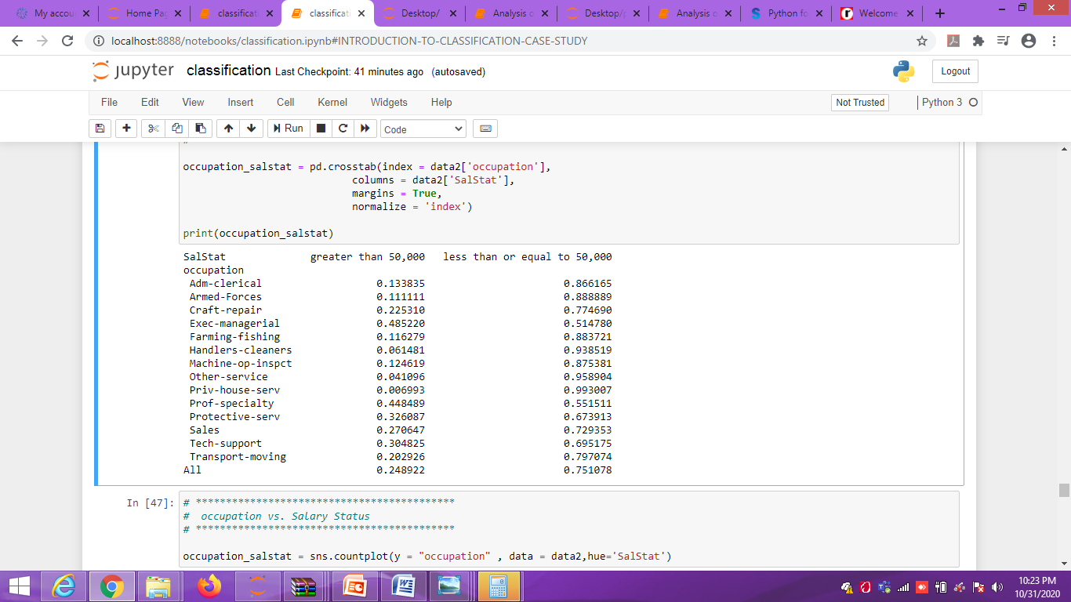

occupation vs. Salary Status
From above observations those who make more than 50,000 USD per year are more likely to work as managers and professionals, hence an important variable in avoding the misuse of subsidies.

Slide 14
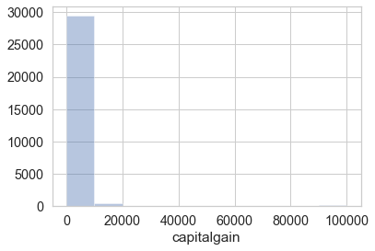
Histogram of capital gain
92% (27611) of the capital gain is 0.

Slide 15
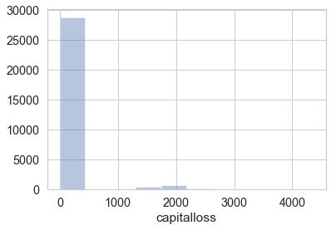
Histogram of capital loss
95% (28721) of the capital loss is 0.

Slide 16
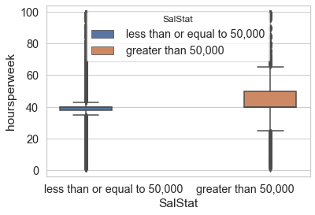
Box Plot - Hours per week vs salary status
From the above plot it is clearly visible that those who make more than 50,000 USD per year are more likely to spend 40-50 hours per week.
This variable can contribute in classifying the individual's salary status since there is association between salary status and hours per week.

Slide 17
Thank you
Stay home, stay safe

